Slide 1
Automatic Number Plate Detection and Recognition in Toll Booth
Team Members Names
MANO BALA.R-16MIS0433
NITHEESHKUMAR.A-16MIS0018
MOHAN.V-16MIS0522

Slide 2
Introduction
This PPT presents a review of Automatic Number Plate Recognition (ANPR) algorithm using image processing in toll booths. On any toll booth the vehicle has to stop for paying the toll.
We are trying to develop a system that would pay the toll automatically and reduce the queue at the toll booths. In this system camera is used for capturing the image of the vehicle number plate.
The captured image would be converted into text using ANPR algorithm. Toll booth passes the vehicle plate number to the central server which holds the information about registered users.
Server then uses this vehicle number to verify whether the user is registered account holder or not.

Slide 3
Introduction
If the user is registered account holder then server transmits the information about vehicle type, account balance to the toll booth.
Based on the vehicle type, toll is deducted from the customer’s account and then the toll gate is opened. Central server is updated with user’s account balance using internet protocols by the toll booth the vehicle passes through.
The user is updated about his account status via SMS.
Keywords: Automatic Number Plate Recognition, Optical Character Recognition, Image processing, Server.

Slide 4
Objectives
Toll gates are usually considered as an inconvenience by travelers not only for the cost of toll, also for the delay at toll booths.
In order to ensure a steady flow of traffic, both staff and drivers require easy access to an efficient communication system covering the specific requirements of toll gates.
Therefore our proposed system is more efficient than the existing one..

Slide 5
Literature Survey
The first report we are discussing is: License Platelocation in Camera Images (Paper 1) This is from Halina Halina Kwaśnicka and Bartosz Wawrzyniak (Wrocław University of Technology)
First it deals with the conditions of the license plate: weather, light, place of number plate, movement, damage and other forms of letters and numbers in the image. Most of these points could be solved by improving light invasion, better cameras and high-quality image processing techniques.
Using algorithms with shape and color would be inefficient because there are many different number plates. The correct way to do Number Recognition is to use the difference between background color and letter color, which is very clear for each number plate.
The second paper is from Naikur Bharat kumar Gohil called Car License PlateDetection. Here the full implementation is discussed in Matlab code.

Slide 6
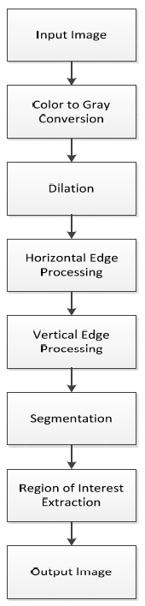
Here's how it works:

Slide 7
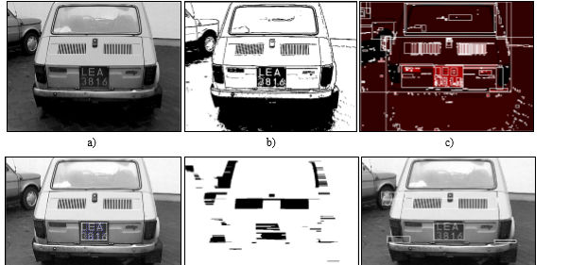
Image Processing

Slide 8
Benifits of the system
Less or shorter queues at toll plazas by increasing toll booth service
Faster and more efficient service
Expand capacity without building more infrastructures

Slide 9
Processes
Color to gray conversion: First, the image is converted to a gray-scale image. Thus, it is easy to read different types of license plates
Dilation: Clarifies the image, fills holes, angles are sharper and noise is removed. Differences between dark and light also become clearer.
Horizontal and Vertical Edge Processing: Each column and row of the image is traversed by the algorithm, calculating the difference in pixel value between neighboring pixels. If the difference in gray value between the successive pixels exceeds a certain size limit, we will add it to the total of that particular column.

Slide 10
Processes
Segmentation: All regions in the image that can contain a license plate are searched. The placed of this is stored in an array.
Region of interest extraction: This is used using Edge processing, the region with the highest histogram value of vertical and horizontal will contain the number plate.

Slide 11
Methodology
To recognize a number plate we will work in several steps:
1. Convert image to binary image
2. Detect edges
3. Edge processing and position determination
4. Segmentation number plate
5. Optical Character recognition

Slide 12
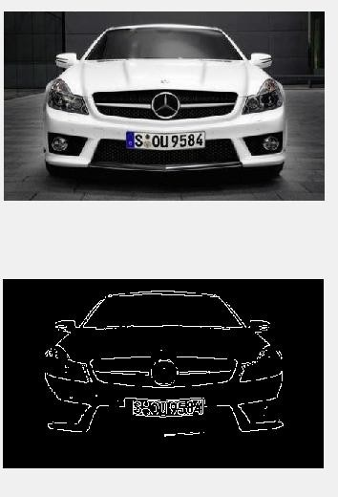
Edge Detection

Slide 13
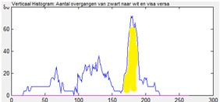
Edge Processing
(x axis: position of row pixels on image, y axis: number of times the difference in gray value between neighboring pixels exceeds a limit value)

Slide 14
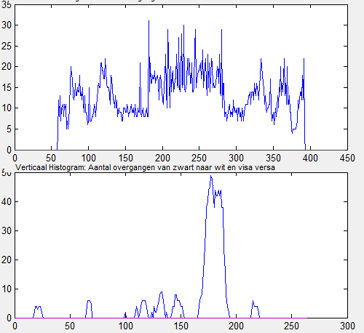
Edge Processing
(x axis: position row on image, y axis upper graph: number of white pixels counted per row, x axis lower graph: number of counted transitions (1> 0.0-> 1) per row )

Slide 15

Edge Processing
we use the calculated positions for segmenting the image. With Figures as a result.

Slide 16
Optical Character Recognition template matching
Although not specified in our specification, we went one step further by implementing an optical character recognition algorithm.
Number plate recognition by Matlab is possible.
So,we use Matlab to extract the numbers..

Slide 17
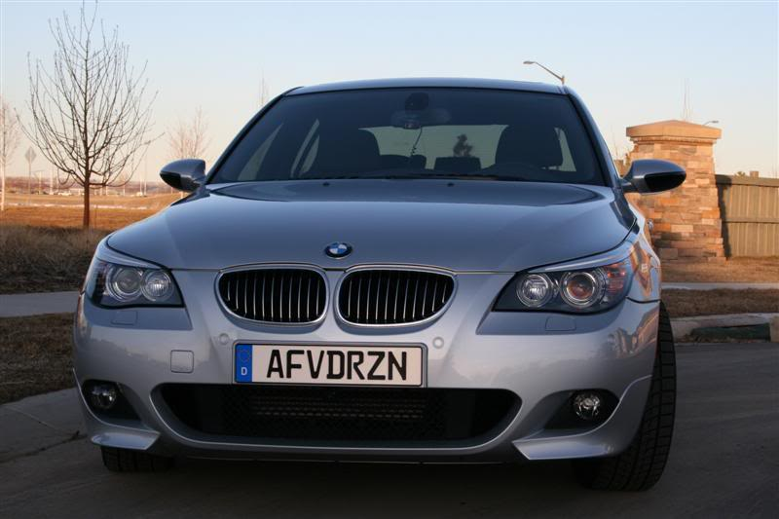

Result
A.Original Image
Extracted Lic. Number

Slide 18
Sources
Paper 1:
HalinaKwaśnicka and BartoszWawrzyniak. (15/11/2002) License plate localization and recognition in camera pictures; 4 blz, beschikbaar op:
http://www.ci.pwr.wroc.pl/~kwasnick/download/kwasnickawawrzyniak.pdf [26/4/2012]
Paper 2:
NaikurBharatkumarGohil (2006) Car License Plate Detection; 72 blz, beschikbaar op:
http://csus-dspace.calstate.edu/bitstream/handle/10211.9/1009/Naikur_Gohil_Project_Report.pd f?sequence=3
Paper 3:
Nicole Ketelaars (April 2002) Final Project: Automated License PlateRecognition; 4blz, beschikbaar op:
http://www.win.tue.nl/aime/Files/apr2002_license.pdf

Slide 19
Bibliography
[1] Clemens Arth, Florian Limberger and Horst Bischof, “Real-Time License Plate Recognition on an Embedded DSP-Platform”, Proceedings of IEEE conference on Computer Vision and Pattern Recognition, pp 1-8, June 2007.
[2] Halina Kwasnicka and Bartosz Wawrzyniak, “License plate localization and recognition in camera pictures”, AI-METH 2002, November 13-15, 2002.
[3] Pramod Kapadia, “Car License Plate Recognition Using Template Matching Algorithm”, Master Project Report, California State University, Sacramento, Fall 2010.

